Slide 1
TEXT Files
COMSC 110

Slide 2
12.1
File Operations

Slide 3
File Operations
File: a set of data stored on a computer, often on a disk drive
Programs can read from, write to files
Used in many applications:
Word processing
Databases
Spreadsheets
Compilers

Slide 4
Using Files
Requires fstream header file
use ifstream data type for input files
use ofstream data type for output files
use fstream data type for both input, output files
Can use >>, << to read from, write to a file
Can use eof member function to test for end of input file

Slide 5
fstream Object
fstream object can be used for either input or output
Must specify mode on the open statement
Sample modes:
ios::in – input
ios::out – output
Can be combined on open call:
dFile.open("class.txt", ios::in | ios::out);

Slide 6
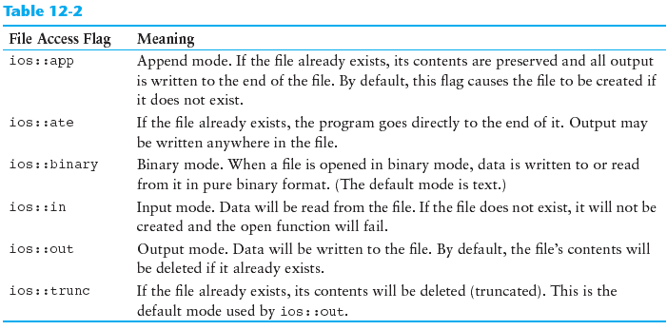
File Access Flags

Slide 7
Using Files - Example
// copy 10 numbers between files
// open the files
fstream infile("input.txt", ios::in);
fstream outfile("output.txt", ios::out);
int num;
for (int i = 1; i <= 10; i++)
{
infile >> num; // use the files
outfile << num;
}
infile.close(); // close the files
outfile.close();

Slide 8
Default File Open Modes
ifstream:
open for input only
file cannot be written to
open fails if file does not exist
ofstream:
open for output only
file cannot be read from
file created if no file exists
file contents erased if file exists

Slide 9
More File Open Details
Can use filename, flags in definition:
ifstream gradeList("grades.txt");
File stream object set to 0 (false) if open failed:
if (!gradeList) ...
Can also check fail member function to detect file open error:
if (gradeList.fail()) ...

Slide 10
12.2
File Output Formatting

Slide 11
File Output Formatting
Use the same techniques with file stream objects as with cout << showpoint, setw(x), setprecision(x), etc.
Requires:
#include <iomanip>
to use manipulators

Slide 12
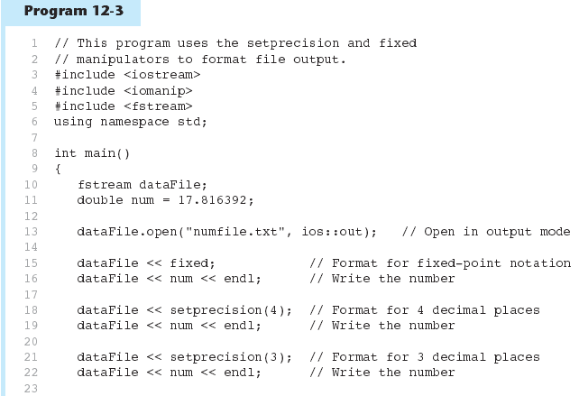

Slide 13
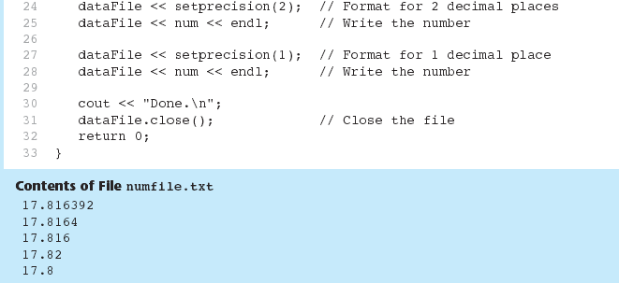
Program 12-3 (Continued)

Slide 14
12.3
Passing File Stream Objects to Functions

Slide 15
Passing File Stream Objects to Functions
It is very useful to pass file stream objects to functions
Be sure to always pass file stream objects by reference

Slide 16
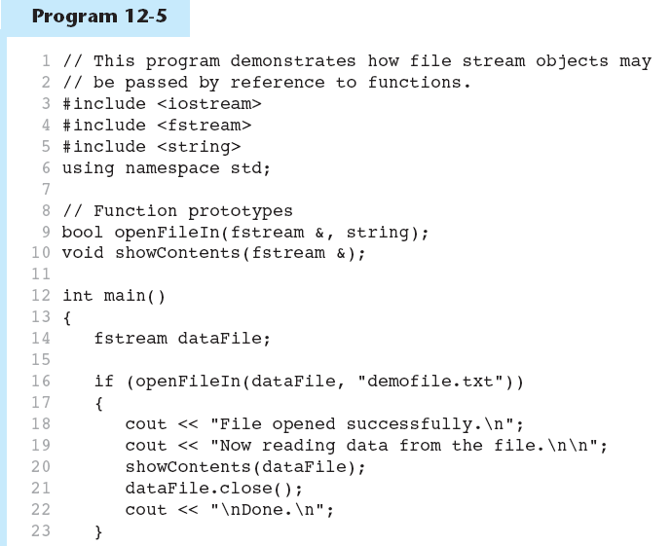

Slide 17
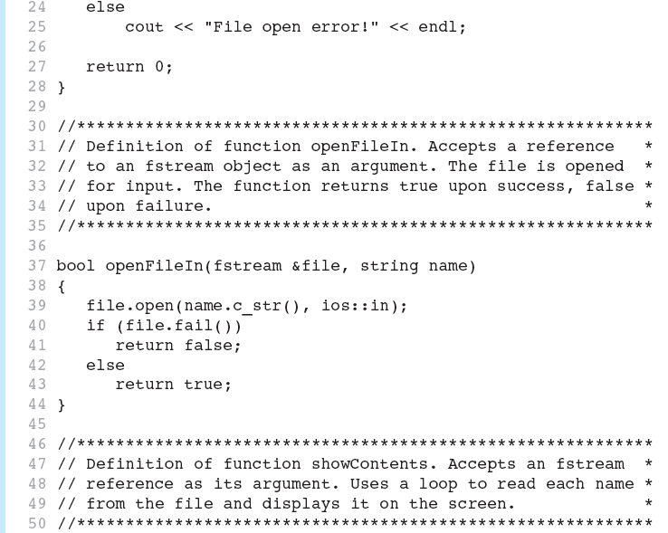

Slide 18
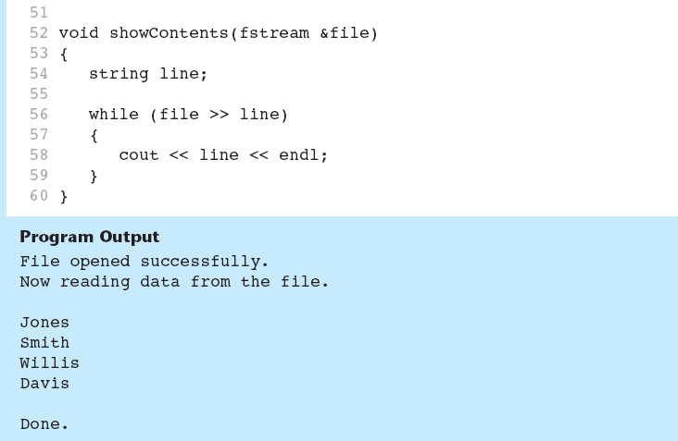

Slide 19
12.4
More Detailed Error Testing

Slide 20
More Detailed Error Testing
Can examine error state bits to determine stream status
Bits tested/cleared by stream member functions
ios::eofbit | set when end of file detected
ios::failbit | set when operation failed
ios::hardfail | set when error occurred and no recovery
ios::badbit | set when invalid operation attempted
ios::goodbit | set when no other bits are set

Slide 21
Member Functions / Flags
eof() | true if eofbit set, false otherwise
fail() | true if failbit or hardfail set, false otherwise
bad() | true if badbit set, false otherwise
good() | true if goodbit set, false otherwise
clear() | clear all flags (no arguments), or clear a specific flag

Slide 22
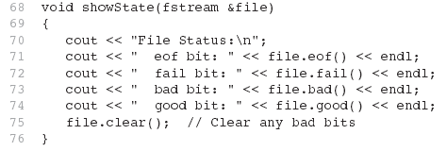
From Program 12-6

Slide 23
12.5
Member Functions for Reading and Writing Files

Slide 24
Member Functions for Reading and Writing Files
Functions that may be used for input with whitespace, to perform single character I/O, or to return to the beginning of an input file
Member functions:
getline: reads input including whitespace
get: reads a single character
put: writes a single character

Slide 25
The getline Function
Three arguments:
Name of a file stream object
Name of a string object
Delimiter character of your choice
Examples, using the file stream object myFile, and the string objects name and address:
getline(myFile, name);
getline(myFile, address, '\t');
If left out, '\n' is default for third argument

Slide 26
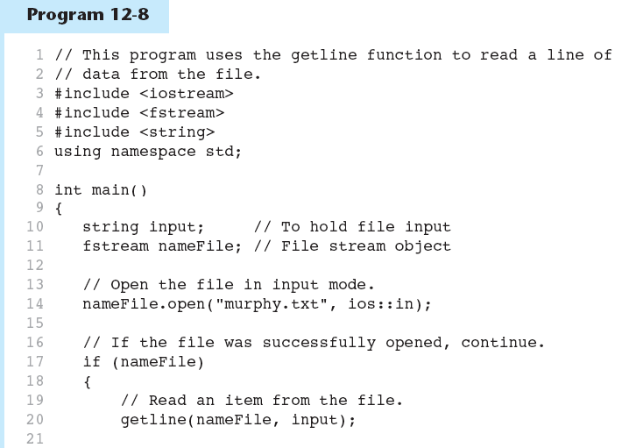

Slide 27
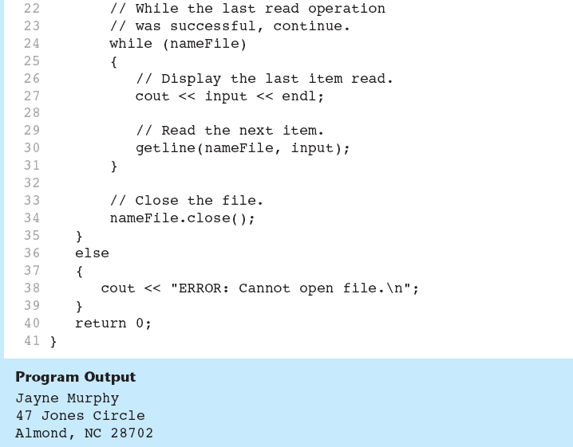

Slide 28
Single Character I/O
get: read a single character from a file
char letterGrade;
gradeFile.get(letterGrade);
Will read any character, including whitespace
put: write a single character to a file
reportFile.put(letterGrade);

Slide 29
12.6
Working with Multiple Files

Slide 30
Working with Multiple Files
Can have more than file open at a time in a program
Files may be open for input or output
Need to define file stream object for each file

Slide 31
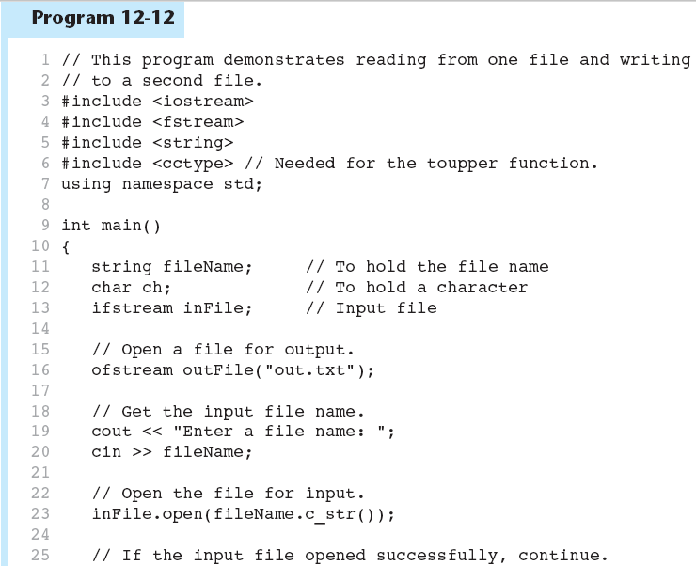

Slide 32
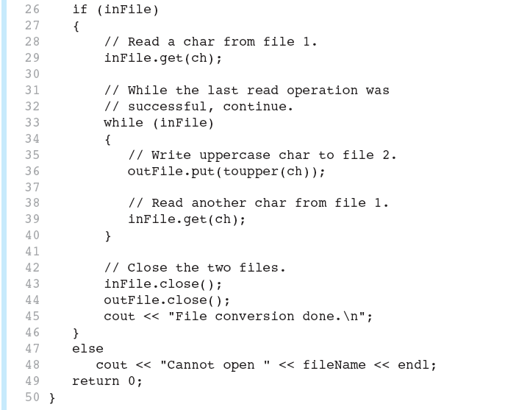

Slide 33
